Slide 1
LOAN MANAGEMENT SYSTEM
By team 4 : Palash Agrawal and Suraj Kumar
Mentor : Javeed Sir

Slide 2
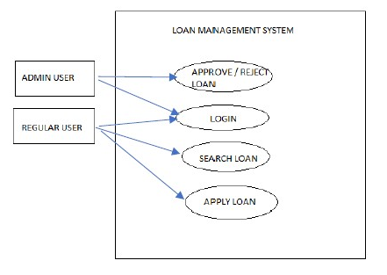
Control Flow Diagram

Slide 3
Technologies Used
Backend : Java, Spring Boot
Frontend : Angular
Databases : MySql
Authentication and Authorization : JWT Token
SonarQube

Slide 4
Customer Functionality
Sign Up as User
Sign In as User
Update Account Details
Apply Loan
Calculate EMI
Check Loan Status
Search & Filter Loans
Update Applied Loan
Cancel Applied Loan
Loan History
Upload Document for Verification
Logout

Slide 5
Admin Functionality
Log In
Create Admin
Create Loan Type
Update Loan Type
Search & Filter Loan Application
Update Customer’s Loan Application Status
Download Document for Verification
Update Account Details
Logout

Slide 6
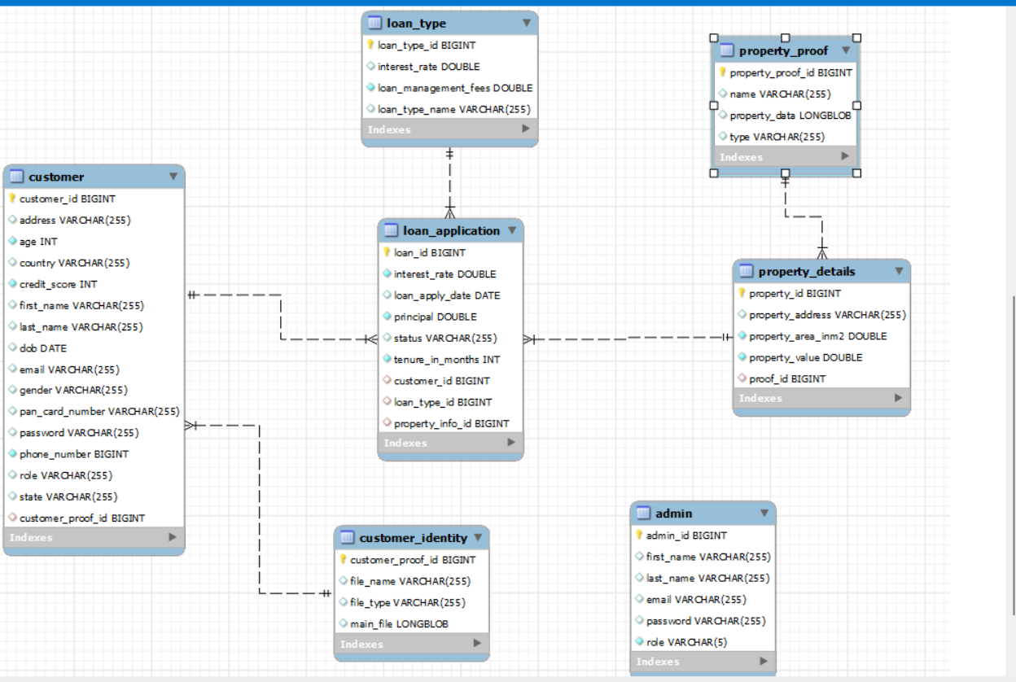

Slide 7
System Flow
Firstly, opening the application will redirect you to the home page.
In the home page, you can view al available loans, and option to sign up and sign in as customer and admin.
If signed in as admin, you will have authority to update customer applied loans status, document verification, create admin, loan type, update account details and Logout
If signed and signed up in as customer, you can apply form loan, check loan status, loan history, calculate EMI, update account details and Logout

Slide 8
Thank You

